Slide 1

VitaSync
Company
VITA SYNC
Introducing Vita Sync, a habit tracker app designed to help users eliminate bad habits and develop positive ones. With a user-friendly interface, customizable reminders, and insightful analytics, users can track progress easily. Vita Sync supports various goals like exercise, healthy eating, and organization, empowering users to succeed in transforming their lives habit by habit.

Slide 2
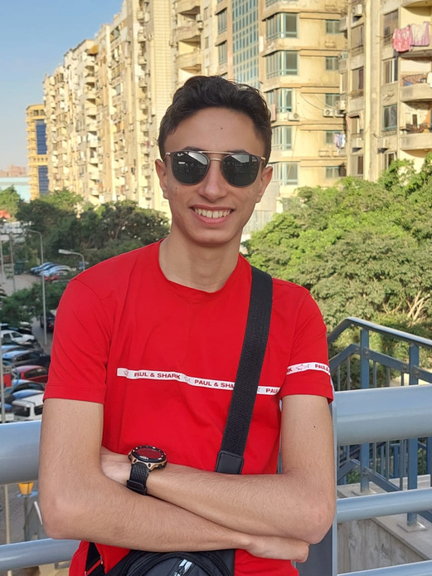
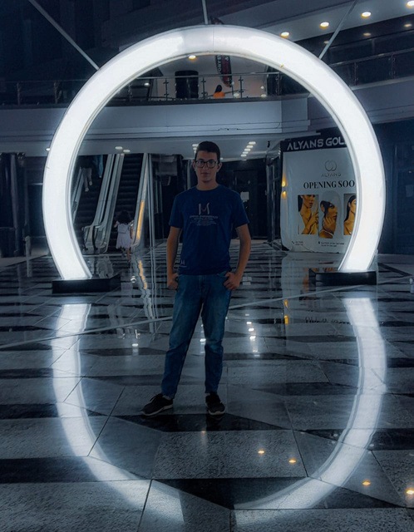

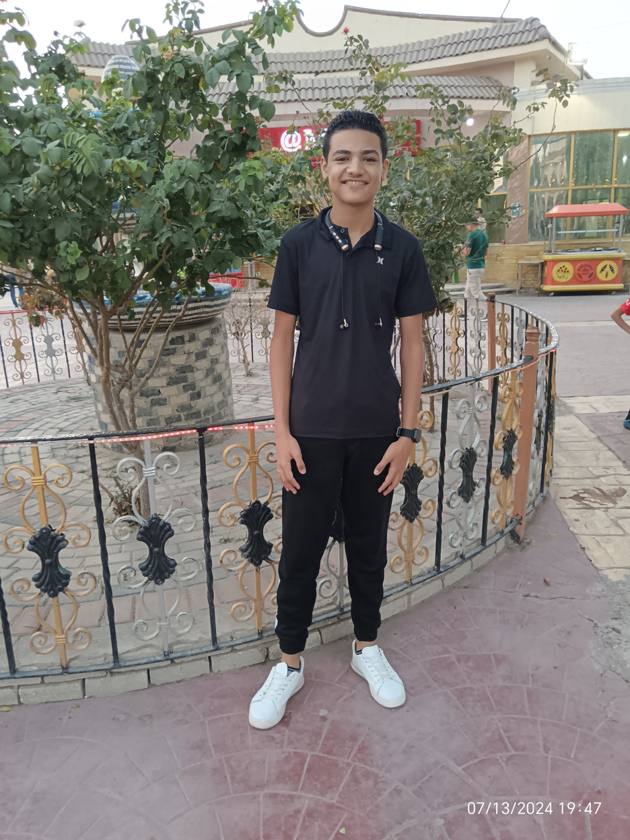
VitaSync
Company
OUR PROFESSIONAL TEAM
EKRAMY EL-ARABY
YASEEN TAHER
MOATASEM BAKA
MOHAMED OSMAN
PRESENTER
LEADER
DEVELOPER
DEVELOPER
& DESIGNER

Slide 3

VitaSync
Company
OUR GOAL IS
Create an app to assist users in breaking bad habits and staying dedicated. The app will offer AI assistance, customized reminders, tracking progress, logging habits, engaging challenges, and a social feature for community backing. Emphasizing a user-friendly interface, data protection, and nurturing a helpful atmosphere. The goal of the app is to be a companion for personal development and enduring achievement.

Slide 4



VitaSync
Company
Application Features
01
02
03
CASH BACK
AI VALIDATION
REMINDERS

Slide 5

VitaSync
Company
CASH BACK
Our innovative habit tracker app includes a unique cash-back feature, where users receive monetary rewards for successfully completing segments of their daily program. This incentive structure is specifically designed to motivate users to stay on track and avoid procrastination, ultimately helping them overcome laziness. By providing tangible rewards, we aim to enhance user engagement and ensure the successful elimination of bad habits, fostering a healthier and more productive lifestyle

Slide 6
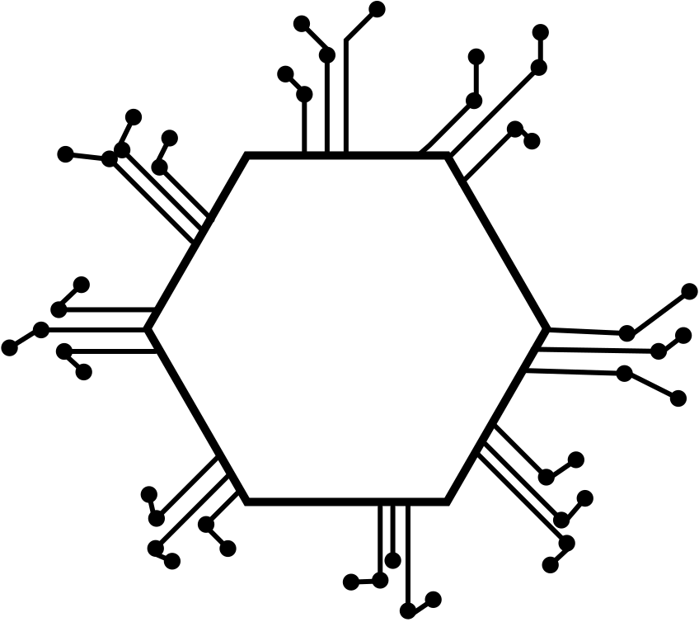

VitaSync
Company
AI VALIDATION
Our habit tracker app leverages advanced AI technology to provide users with the most effective programs for overcoming bad habits. By analyzing the data input by users and recognizing patterns in their behavior, the AI generates personalized recommendations tailored to each individual's needs. Additionally, the AI automates much of the data entry process by filling in information based on user inputs and detected patterns, reducing the need for manual logging. This intelligent feature streamlines the user's experience, making it easier and more efficient to stay on track and achieve their habit-changing goals.

Slide 7
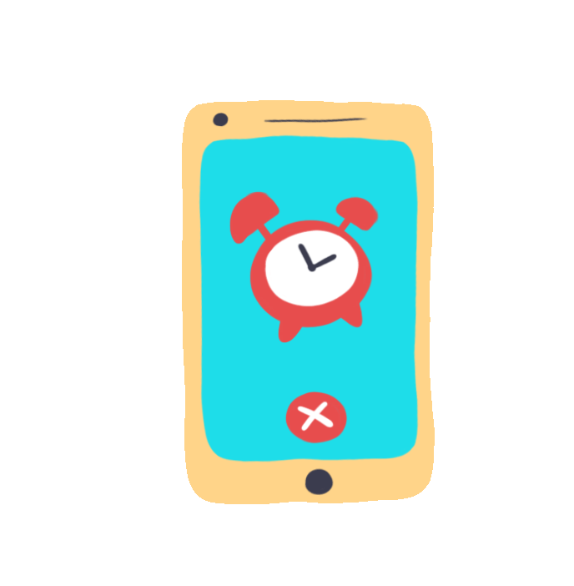
VitaSync
Company
CUSTOMIZABLE ALARMS
Our habit tracker app includes customizable alarms designed to notify users about specific parts of their daily program. These alarms can be tailored to suit individual preferences, ensuring users receive timely reminders that help them stay committed to their routines without feeling overwhelmed or frustrated by excessive notifications. This feature strikes a balance between keeping users on track and maintaining a stress-free experience, promoting consistent progress towards their goals.

Slide 8



VitaSync
Company
OUR APP SERVICES
Our habit tracker app features a vibrant community where users can connect, encourage each other to stay active, and collaborate on their activities. This supportive network allows users to ask questions about their programs and share their experiences, creating an environment of mutual motivation.
Our habit tracker app features a competitive leaderboard that motivates users to earn more points for rewards and higher cash-back percentages. This system encourages users to stick to their programs and engage with the community, driving consistent progress and fostering a sense of camaraderie.
Our habit tracker app includes comprehensive guides that help users input data accurately, ensuring a smooth and precise tracking experience. These guides are designed to streamline the process, making it easier for users to maintain an effective program and ultimately simplify their journey in overcoming bad habits.

Slide 9




VitaSync
Company
WHAT WILL YOU GET?
Data Privacy
Fast Perfomance
Users will be able to see and know how their data is collected, how it is stored and how it is being used.
Our app is engineered for a fast performance and flawless operation, ensuring a glitch-free experience. With its sleek and responsive design, users can enjoy an effortless journey
High Security System
Compatible All Device
Our app is equipped with top-notch security measures, including robust defensive walls and comprehensive bug bounty testing, ensuring that user data remains safe.
Our app seamlessly integrates with smartwatches ,and other devices, delivering a unified experience across your tech ecosystem.so you can enjoy a secure and connected lifestyle.

Slide 10

VitaSync
Company
GROWING UP YOUR LIFESTYLE
Elevate your daily routine with our app, designed to help you enhance every aspect of your lifestyle. From building effective habits to setting and achieving personal goals, our features provide the support and motivation you need for a more balanced and fulfilling life. Embrace the opportunity to transform your habits and routines, and experience the positive changes that come with a more organized and purposeful lifestyle. Your journey to personal growth starts here!

Slide 11





WE CARE ABOUT YOUR
FEEDBACK
Your feedback is crucial for enhancing the app and creating a better experience for all users. We value your input, and we will address each comment to ensure they have a significant impact on the app and, most importantly, on the user experience.
Sebastian Bennett
Sacha Dubois
I adore this app! I used to smoke a lot, but when I started using this app, the experience was seamless. The programs were excellent and enjoyable until the end. I definitely recommend this app.
This app is excellent, offering engaging programs and a supportive community that motivates and supports you until you successfully break free from bad habits.

Slide 12
VitaSync
Company
Annual
plan
Monthly
Plan
$220 / Year
$20 / Month
APP PACKAGES
VIP
Plan
Select the plan that best fits your needs and enjoy access to features tailored for your goals. Each option offers great value to enhance your productivity and success. Thank you for choosing us!
$285/ Year
a vip community
Early Access to Events
More Customization Options

Slide 13
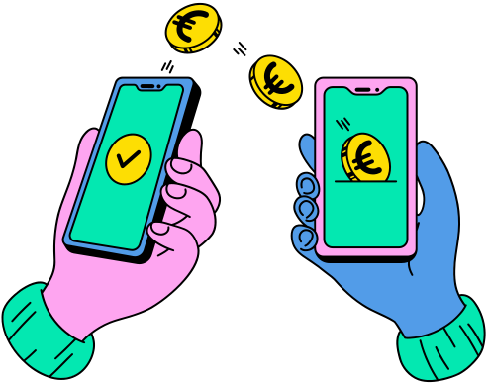
VitaSync
Company
PAYMENT MANAGEMENT MADE EASY
For a seamless payment process, please reach out to us on WhatsApp to obtain your payment code. We offer convenient payment options including VD Cash, ET Cash, InstaPay, and Credit Card. Once you receive your code, you can use it to activate your account and start enjoying all the benefits of VitaSync. Thank you for choosing us—we’re excited to support you on your journey!

Slide 14
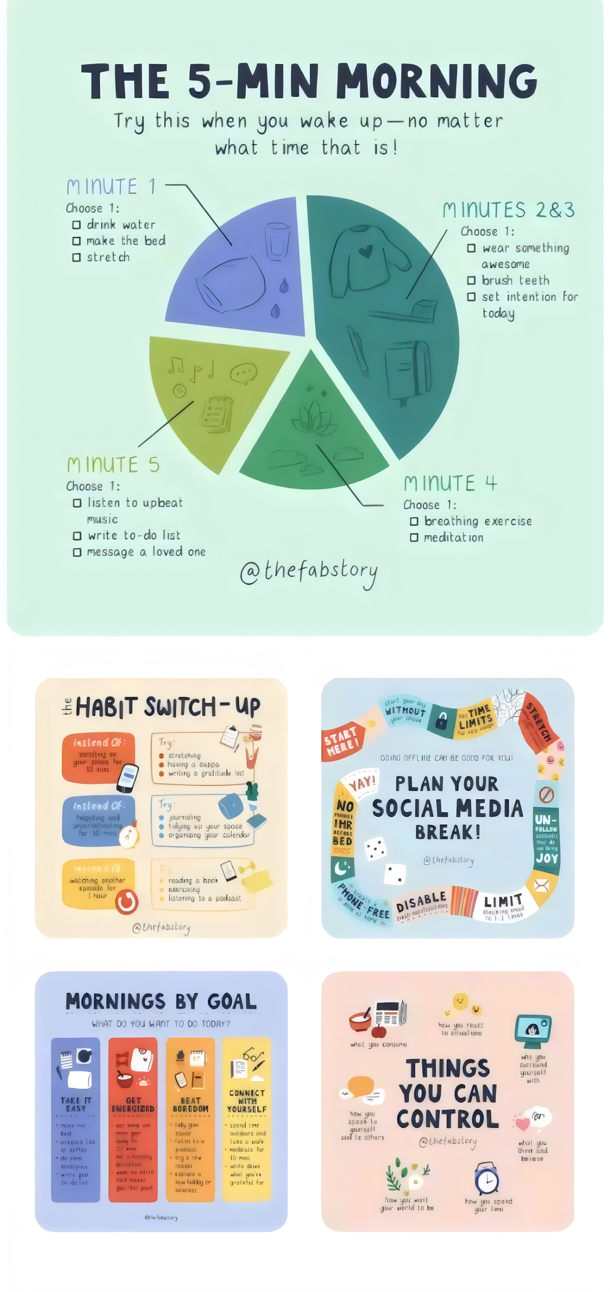
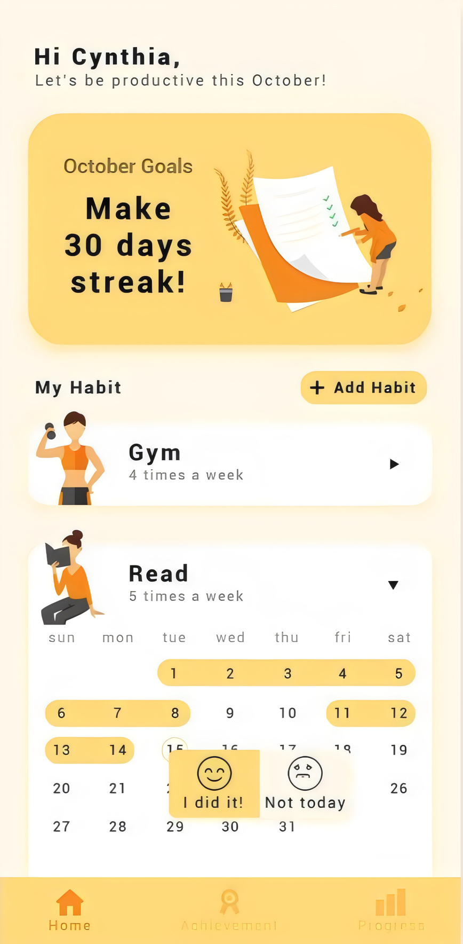
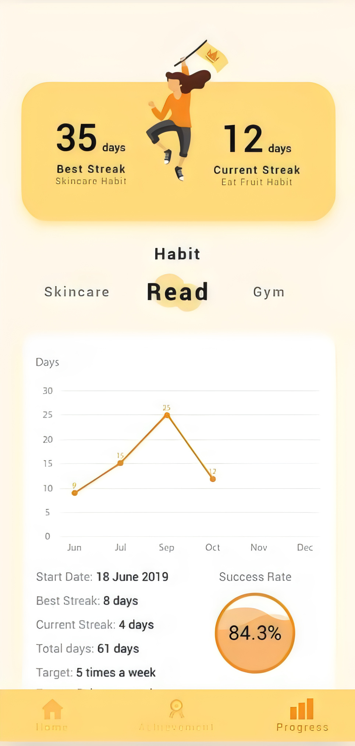
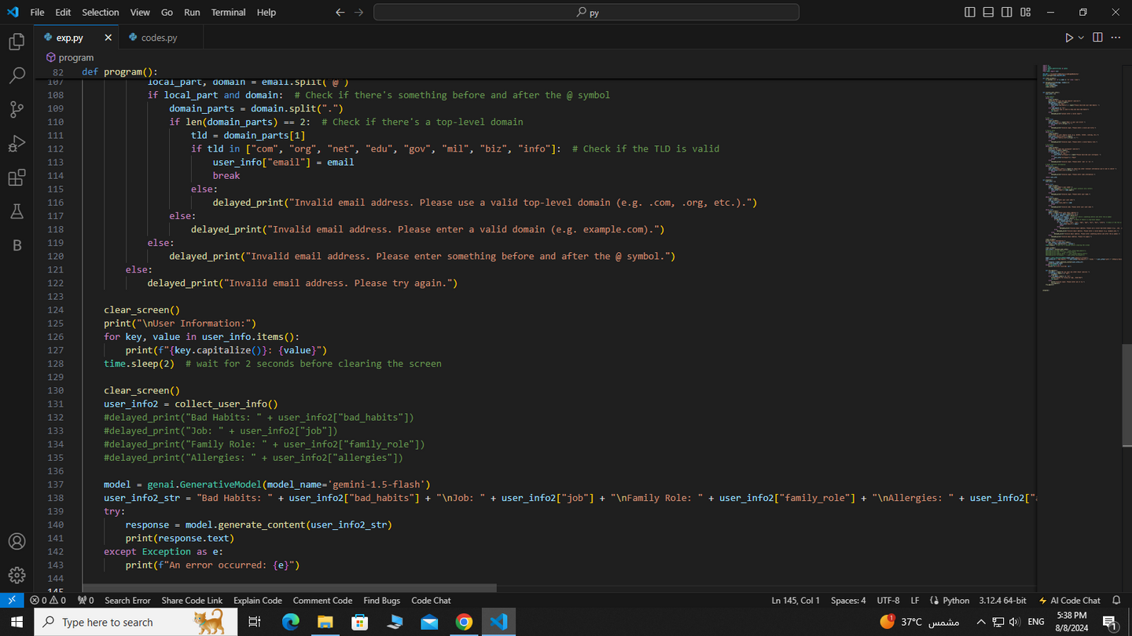
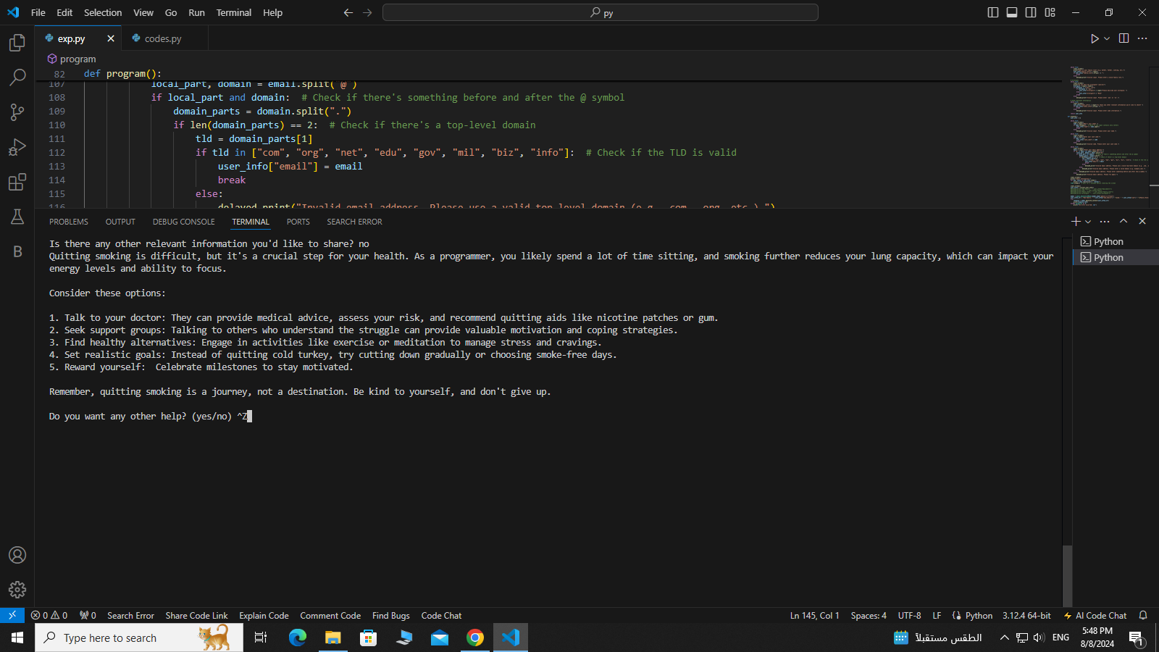
Install Now

Slide 15
VitaSync
Company
THANK YOU
We sincerely appreciate your interest in VitaSync, your new partner in cultivating healthier habits and achieving your personal goals. Your commitment to improving your daily routine and overall well-being means a lot to us. As you embark on this journey with VitaSync, we're here to support you every step of the way. Thank you for choosing us to be a part of your path to a more balanced and fulfilling life. Your dedication inspires us, and we’re excited to see the positive changes you'll make with VitaSync by your side. Keep striving, and remember: every small step leads to significant progress!

Slide 16
